Slide 1

Wireless Charging System
An Innovation to make your life easier . . .
V VDAT 2019
IIIT Naya Raipur
Group Members : Ruchi Dhamnani
Ananya Garg
Purvi Agrawal

Slide 2

Outline:
· Introduction
· Objective
· Motivation
· Literature Survey
· Proposed Solution
· Result
· References

Slide 3

Introduction:
Inductive charging uses an electromagnetic field to transfer energy through electromagnetic induction.
Energy is sent through an inductive coupling to device, which can then use that energy to charge batteries or run device.
The underlying principle behind wireless charging is the well-known Faraday’s law of induced voltage, used in motors and transformers.

Slide 4

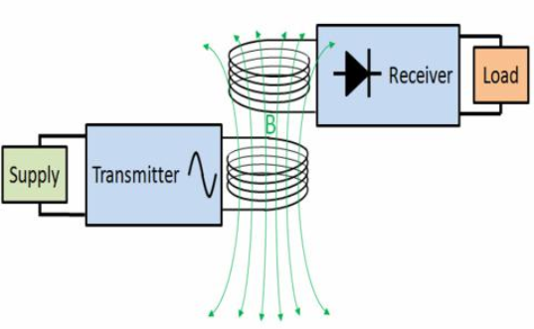
Objective
To introduce a system capable of charging the devices wirelessly.
Thus bringing an innovative idea to propose a new method to control power division.
The two-coil structure with different resonant frequencies of the sending and receiving loops is modeled and analyzed.
Because Action without Vision is nightmare...

Slide 5

Motivation :
Convenient when electrical contacts are not acceptable.
Reduces the amount of cables and power adapters
It can also charge battery at a fast rate depending on the size of the battery pack.
In most applications the distance between the two coils is typically 5cm. It is possible to extend that range to at least 35cm.
In order to become the 1% you must do what the other 99% won’t !!!

Slide 6
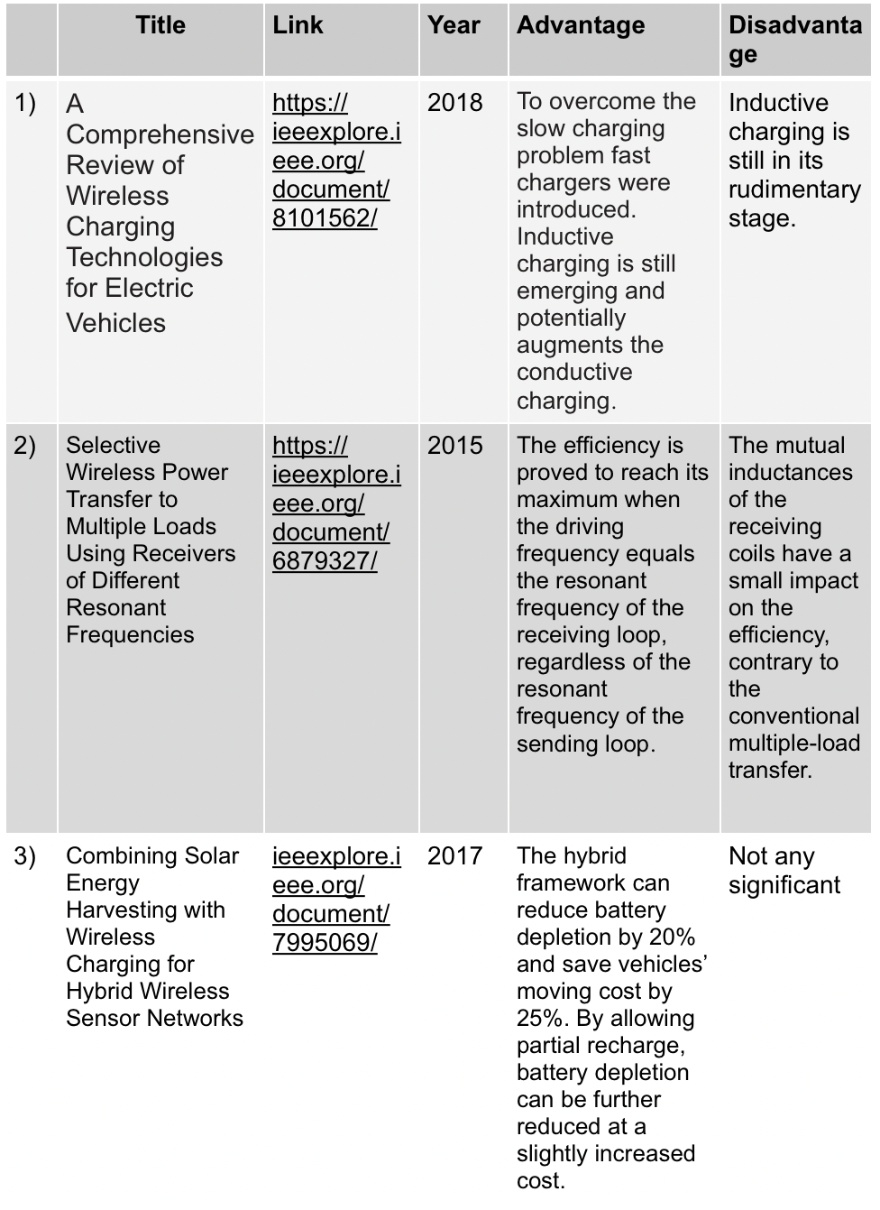

LITERATURE SURVEY

Slide 7
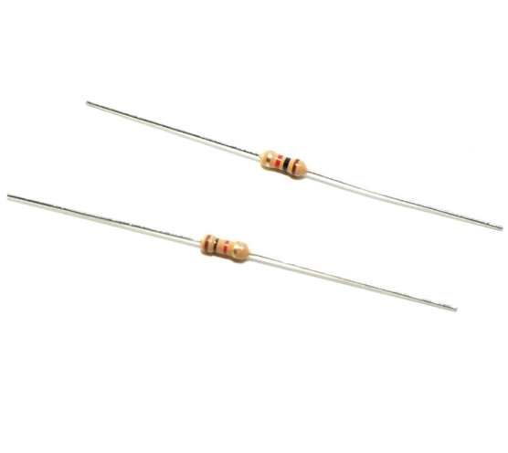
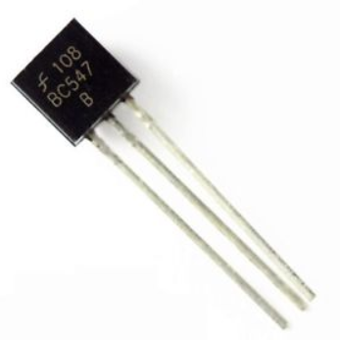
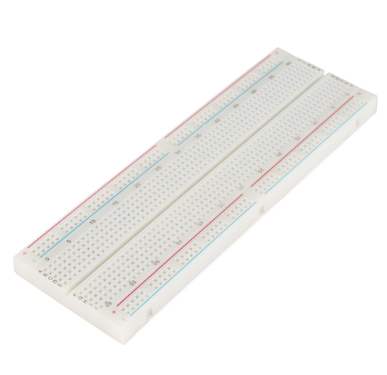

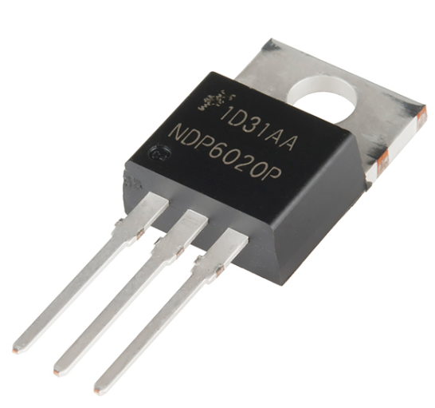
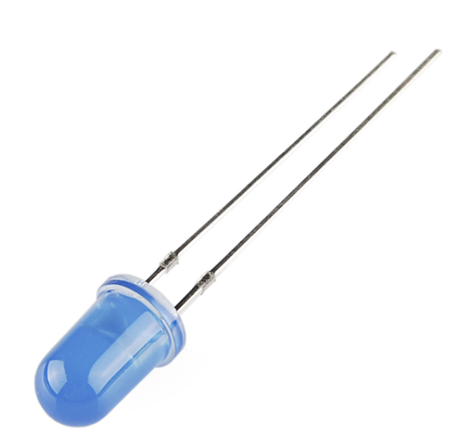
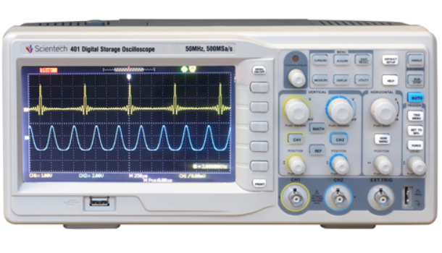
Components used:
Transistor - BC547(npn), BC548(pnp).
Resistor - 10k,3k,2k,1k.
Breadboard.
Functional Generator.
Oscilloscope.
Power Supply.
Metal Oxide Semiconductor Field Effect Transistor.
Bipolar Junction Transistor.
Light Emitting Diode.
Inductors.

Slide 8
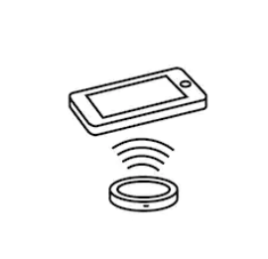
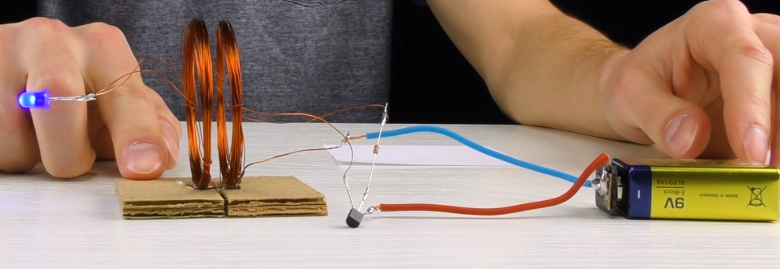
Proposed Solution:
In a two-coil system with different resonant frequencies of the sending and receiving loops, efficiency is proved to reach its maximum at the resonant frequency of the receiving loop, regardless of the resonant frequency of the sending loop.
Changing the driving frequency can determine the efficiency of a particular load.
An individual load can obtain high output power and efficiency at its own resonant frequency.

Slide 9
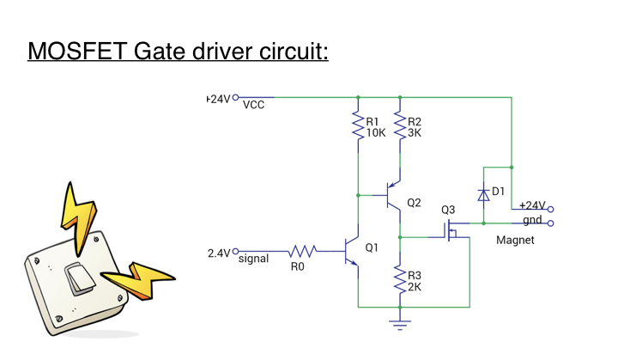

Slide 10
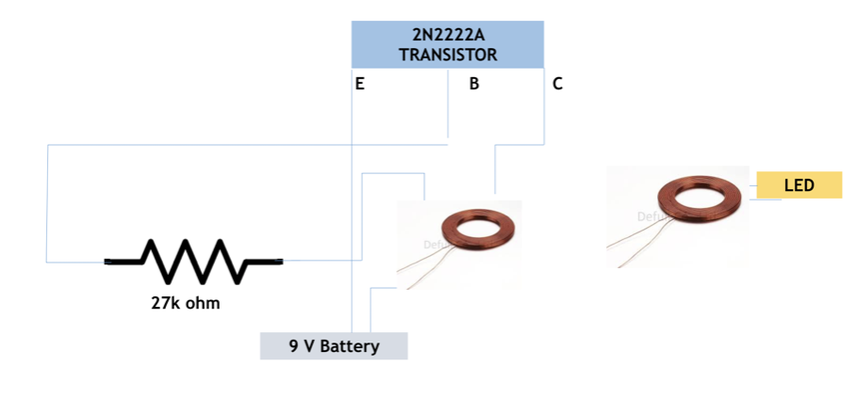
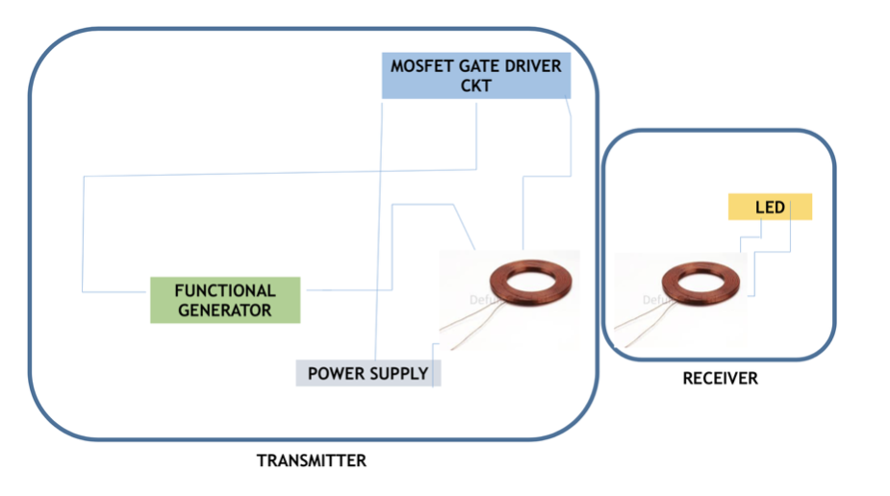

Block Diagram:
Wireless charging using Inductive Power Transfer
Wireless charging using MOSFET Gate Driver Circuit

Slide 11

Steps Followed:
Designed inductors from copper coil of 22 gauze
Measured resonant frequency as 9.65Mhz
Designed MOSFET gate driver circuit
Input square wave of 2.4V frequency 9.65Mhz
Input 24V from Power supply to both the resistor
LED glows,wireless power transfer occurs

Slide 12
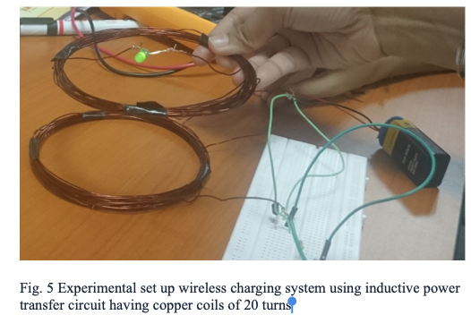
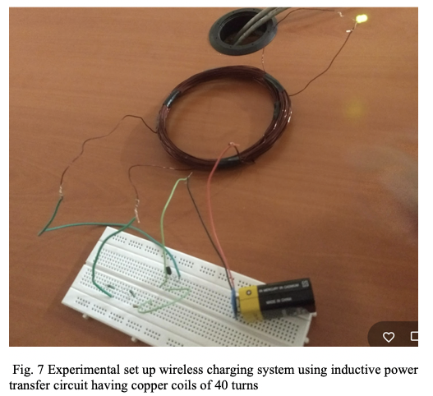
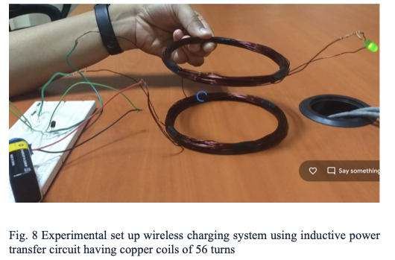
Circuit Implemented: using Inductive Power Transfer

Slide 13
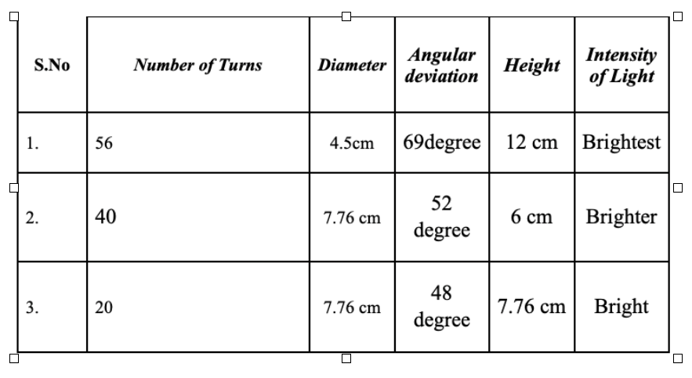
Comparison for different number of turns in an inductive coil

Slide 14


The intensity of the load (LED) varies for different number of turns in the transmitting and receiving coils.
The maximum intensity has been obtained which has the maximum number of turns in the coil.
The inductive coil with 56 turns possesses an approximate of 54.6% and 15.9% improved wireless power transfer in comparison to the circuits having 20 and 40 turns, respectively.

Slide 15

Future Plans:
We will find new ways from inductive coupling how to maximise power transfer.To increase the distance between transmitter and receiver while ensuring maximum efficiency.
The proposed charge transfer technique is useful for applications such as mobile battery charging, LED glowing, Electric vehicles, computerised cameras, media players, gaming controllers, bluetooth headsets, controlling instruments, therapeutic gadgets, e-bicycles, etc.

Slide 16
References:
[1] J. Dai and D. C. Ludois, “A survey of wireless power transfer and a critical comparison of inductive and capacitive coupling for small gap applications,” IEEE Trans. Power Electron., vol. 30, no. 11, pp. 6017–6029, Nov. 2015.
[2] J. M. Miller, O. C. Onar, and M. Chinthavali, “Primary-side power flow control of wireless power transfer for electric vehicle charging,” IEEE Trans. Emerg. Sel. Topics Power Electron., vol. 3, no. 1, pp. 147–162, Mar. 2015.
[3] C. Qiu, K. T. Chau, C. Liu, and C. C. Chan, “Overview of wireless power transfer for electric vehicle charging,” in Proc. Electr. Veh. Symp. Exhib. (EVS), vol. 7. Apr. 2013, pp. 1–9.
[4] S. Y. Choi, B. W. Gu, S. Y. Jeong, and C. T. Rim, “Advances in wireless power transfer systems for roadway-powered electric vehicles,” IEEE Trans. Emerg. Sel. Topics Power Electron., vol. 3, no. 1, pp. 18–36, Mar. 2015.

Slide 17


